Slide 1
HEALTH SYSTEM ACHIEVEMENTS AND CHALLENGES
GEORGIA
Dr. David Sergeenko
Minister of Labour, Health and Social Affairs
24 January, 2018
Notes:
Dear members of the Executive Board, dear guests, I would like to welcome all of you on behalf of the MoLHSA and Georgian society. I would like to thank WHO and particularly WHO/Euro and Dr Zsuzsanna Jakab for this opportunity to present the Georgian health system achievements and challenges. On the side meeting during the Executive board it’s a great honor for me and my country. Generally, the collaboration with the WHO is a great honor for Georgia and our health system.
We are member of the Who since 1992 and the Who played and plays significant role for the Georgian health system.

Slide 2

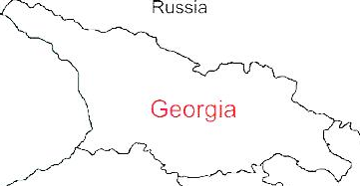



Demographic and Socio-Economic Situation, 2016
Population – 3 719 300
Birth rate (per thousand population) – 15.2
Mortality rate (per thousand population) – 13.7
Life expectancy at birth – 72.7
Maternal Mortality (per 100000 live birth) – 22.9
Infant mortality (per 1000 live birth) – 9.0
Under 5 mortality rate (per 1000 live birth) – 10.7
GDP per capita (at current prices), (2016) – 3852 $US
GDP real growth – 2.7%
Government expenditure on health per capita – 104 $US
Government expenditure on health as % of GDP – 2.8%
Government expenditure on health as % of State Budget – 8%
Government expenditure on health as % of GDP – 3%
General Government expenditure on health per capita (USD) – 116
Notes:
The population of Georgia has declined during the last 25 years, largely due to the outmigration and according to the census conducted in 2014, it is 3,7 mln.
Georgia has made a good progress in improving health outcomes. Life expectancy has increased by about 4 years over the few decades and currently is at 72.7 years.
Significant declines in under-five mortality and infant mortality and Georgia has been able to reach the Millennium Development Goal 4

Slide 3
25 years: Collapse, Stabilization, Acceleration, Development …
Civil war
Notes:
Georgia went through turbulent past 25 years that are characterized by collapse, stabilization, acceleration, crisis and rebound… During these 25 years the country went through two wars - civil war, conflicts in Abkhazia and South Ossetia resulting in a large number of internally displaced persons, and in 2008 war between Georgia and Russia.
important landmarks: in 2012: Peaceful transfer of power (Georgia Dream Party), signing of the Association Agreement with the EU in 2014 and in 2017, visa free travel to the EU.
During these years Georgia’s health care system has undergone several reforms, in late 1990s moving strongly away from Semashko model and decentralization of the health care system, extensive privatization introduced by the reforms in 2007-2012 which were also characterized by deregulation and trust in market mechanisms. At that time most government spending on health was channeled through private health insurance. Following the extensive privatization, most providers are independent of government in terms of ownership and management.

Slide 4
Economic Growth
3.5 %
Average GDP growth during 2014-2016, when most of Georgia’s neighbors were in or close to recession.
4.8 %
Average economic growth in 11 months of 2017
4.9 %
Average real GDP growth projection in 2018-2022, according to IMF
Notes:
Georgia, by World bank classification, is still low middle developed country
Average GDP growth during 2014-2016, when most of Georgia’s neighbors were in or close to recession. GDP per capita is 3852 US$.
After 2012 doubled foreign direct investment in the county and significant increase as % of GDP from 6% to 12%

Slide 5
Unemployment and Poverty Indicators
2016
annual unemployment rate reached its lowest point in 13 years
2009-2016
Decreasing trend of unemployment rate
Notes:
Country has a positive trend to decrease unemployment, as well as absolute poverty and relative poverty indicators

Slide 6
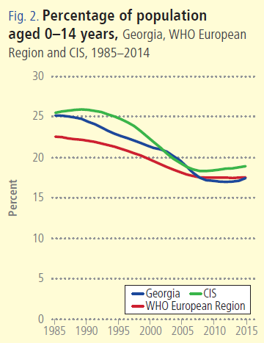
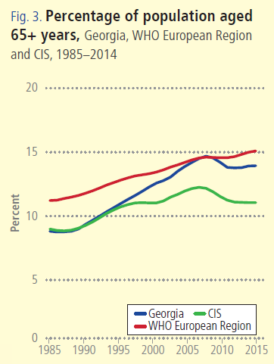
Notes:
Georgia, as many countries in the WHO European Region is facing a similar demographic challenges – ageing population and a declining birth rates.

Slide 7
Non-communicable diseases are the primary driver of overall disease burden
Cause of Burden of Disease (DALYs)
Injuries
Communicable
diseases
1990
2005
Non-communicable
diseases
2015
Notes:
If we look at the diseases burden, non-communicable diseases are the primary driver of overall diseases burden and it has been for a long time. The major causes of death in Georgia are related to non-communicable diseases, including cardiovascular diseases, cancer, diabetes and chronic respiratory diseases, which together with injures make 94% of deaths.
The large share of premature deaths from NCDs are influenced by the health-related behaviors and risk-factors. STEPs survey results, which was conducted in 2016 in Georgia with WHO support second time showed low physical activity, unhealthy diets, smoking and heavy alcohol consumption among the population.
An important breakthrough in this direction is an adoption of tobacco control law in May 2017, the law that is fully aligned with the WHO Framework Convention on Tobacco Control and is one of the strongest tobacco control laws in the European region. Large–scale antitobacco campaign and health promotion national programme with a strong tobacco control component will be implemented to strengthen tobacco control measures.

Slide 8
Incidence of TB, Georgia, WHO European Region, CIS, 1990-2016
Incidence of HIV, Georgia, WHO European Region, CIS, 1990-2017
* Data for 2017 are preliminary
Notes:
Georgia has achieved remarkable progress in fight against Tuberculosis. During the last several years TB case notification has been decreasing on average by 9% annually and based on a robust and sustainable surveillance system, this trend seems to reflect a genuine reduction in incidence. From 2016 Georgia is not listed among the high MDR TB burden countries;
The country met MDG 6c and the Stop TB Partnership 2015 targets of reducing the prevalence and mortality rates of TB by 50% compared to 1990 and demonstrated commitment to achieve the milestone of further reducing TB incidence as part of the End TB strategy. Despite the achievements, anti-TB drug resistance is a key challenge for the national TB program.
Georgia is considered as a country with low prevalence of HIV/AIDS. However, in recent years incidence of HIV/AIDS is characterized by the growing trend.
The Georgian Antiretroviral therapy (ART) program was recognized by the international experts as one of the best in the region due to universal access to HIV treatment, high coverage of target populations and improved quality of the program interventions. Also, Georgia one of the first in the region started implementation of WHO “Treat ALL” strategy from December 2015.
2017 was the first year when declining of the HIV incidence was marked.

Slide 9
Maternal Mortality ratio per 100000 live birth, Georgia, WHO European Region, EU, 2000-2017
Infant Mortality ratio per 1000 live birth, Georgia, WHO European Region, EU, 2000-2017
* Data for 2017 are preliminary
Notes:
The infant mortality rate and under five mortality rates have declined during the past several years, however, it is still higher than the Region’s average.
Georgia has achieved remarkable progress in reducing under–five and neonatal mortality rates to 10.2 and 6.1 per 1000 live births respectively by 2015 thus accomplishing the Millennium Development Goal #4 (MDG) set at the 2000 Millennium Summit: Reduce by two-thirds, between 1990 and 2015, the under-five mortality rate.

Slide 10
Universal Health Care – Socially Oriented Political Platform
Reforms have moved Georgia closer to universal health coverage
Unprecedented Expansion of State Budget for Health care
365 mill GEL in 2012 → 1017 Mill Gel in 2016
Launch of Universal Health Care Program in February 2013
Better access to care
Better user experience
Better financial protection
Notes:
The main goal of the elected government in 2012 and re-elected in 2016, is the poverty reduction and socially oriented political platform. The strong political will pledged in the election platform was translated into an unprecedented, in 2013 almost 2-fold expansion of budgetary allocation for health.
The second major step towards securing enjoyment of health rights in the country was the launch of a Universal Health Care Program in February 2013. Georgia now has a foundation of universal entitlements within its health system, representing a major step towards improving access to health services for the entire population.
Although the health impact of the UHC program remained to be seen and will be apparent in the medium to long-term, very important achievements and results are already visible, specifically with respect to the financing scheme and greater equity in the health system.
The survey carried out by the World Bank, the World Health Organization and the US Agency for International Development showed the main achievements of the Universal Healthcare Program: increased access to medical services, increased utilization of medical services, reduced financial barriers and enhanced coverage

Slide 11
Health sector expenditures
Out-of-Pocket Payment as % of Total Health Expenditure, Georgia
Public Health Expenditure, Georgia
Source: Georgia NHA 2010-2016 (MoLHSA, 2017)
Notes:
The UHC program was accompanied with a substantial increase in the governments budget allocations. From 2012 to 2016, the health budget more than doubled, as a percentage of GDP it increased from 1.7 percent to 3% in 2016, but it’s still lower in comparison with Euro average.
The share of the out-of-pocket payments in total health expenditures has significantly decreased from 73% (in 2012) to 57% (in 2015), mainly due to the lower cost of hospitalization, which is a direct consequence of the universal healthcare program.

Slide 12
Coverage of Healthcare services
Services utilization
Hospitalization per 100 population
  UHC Program has led to a major expansion in population entitlement to publicly financed health services (HUES)
Ambulatory care visits per person per years
Notes:
The coverage of population improved as demonstrated by the series of health care utilization and expenditures surveys. Over half of the population were covered first time. We have seen a surge in utilization of the health care services. In Georgia, during last 2 decades, this indicator did not exceed 2.2. In the frame of the UHC programme the numbers of out- and in-patient encounters continued to grow due to increased accessibility of healthcare services. In 2016, the number of contacts with out-patient facilities per capita reached 4.0.

Slide 13
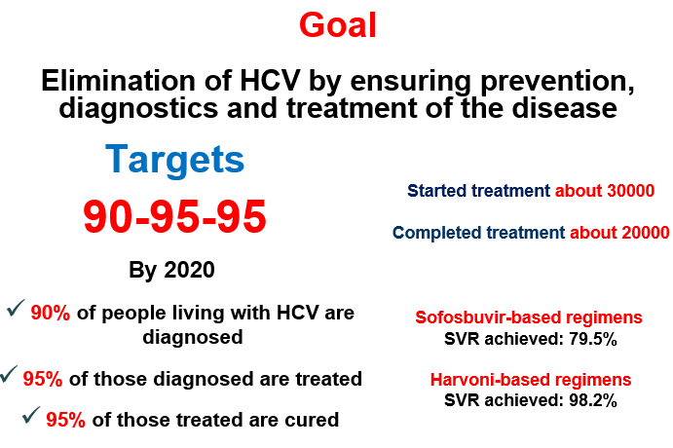
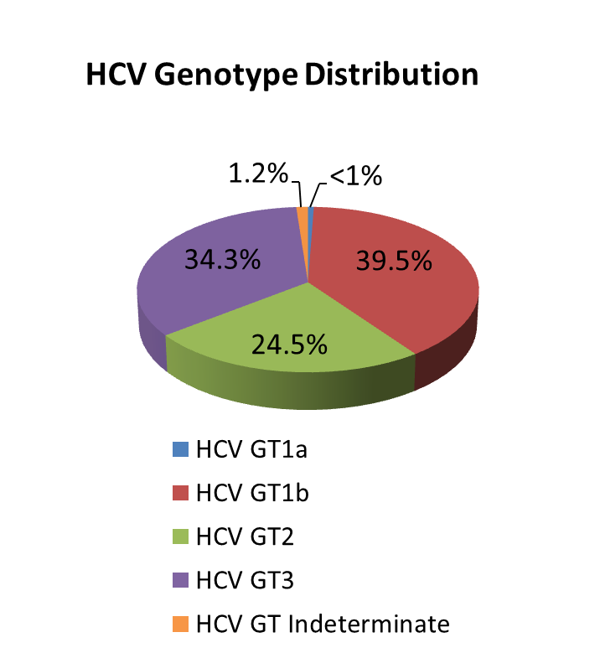
National Hepatitis C Elimination Program
National wide survey, 2015
Anti-HCV+ | 7.7%
HCV RNA+ | 5.4%
Screened - 1,200,00
Started Treatment - 43000
Completed treatment - 38506
Sofosbuvir-based regimens
SVR achieved: 82%
Harvoni-based regimens
SVR achieved: 98.2%
Notes:
One of the important flagship program in Georgia is Hep C elimination by 2020. Georgia became on of the model country globally, we have a very ambitious goal and hope to reach this goal by 2020. In 2015, Hepatitis C elimination program - This flagship public-private partnership has been launched, with greatest efforts of the Government of Georgia, the US Center for Disease Control and the World Health Organization and with support of the pharmaceutical company "Gilead". Starting with 4 sites in 2015, currently 32 service centers in different cities, including 1 center in penitentiary system, are providing diagnostic and treatment services to the elimination program beneficiaries. Since the launch of the program in 2015 through January, 2018, 42597 patients started and 38506 patients completed the treatment. Cure rate reached 98.2%.
Based on available data, Georgia is among the countries with high hepatitis C (HCV) Prevalence. 2015 National survey conducted by NCDC and CDC revealed that ~150 thousand people are infected with active HCV infection and need to be treated. The survey estimated that 7.7% of population are anti-HCV positive and 5.4% are HCV RNA positive.

Slide 14

Public health Emergency Preparedness and Responsible Capacity
The revision of Epidemics, Pandemics and Biological Incidents Response Plan
Updating/Developing disease specific plans:
    Influenza Response Plan
    Ebola virus
    Zika Virus
    Crimean-Congo Hemorrhagic fever
    Polio
    Dengue
Emergency Preparedness
WHO IHR was fully implemented in 2012;
NCDC was designated as the national IHR Focal Point;
24/7 Duty Officer System is established;
Georgia, together with other countries is actively involved in support of the 11 Action Package objectives:
  Real-Time Surveillance - as a leading country
  National Laboratory System – as the contributing country
  Zoonotic Diseases – as the contributing country
GHSA
IHR
Notes:
Strengthening of the Public health Emergency Preparedness the highest priority for our country, we are strongly following the requirements of the IHR and GHSA.
Georgia reached the full compliance with the core IHR requirements by the June 2012 deadline set by the World Health Organization (WHO).
Georgia is a part of the GHSA since its initiation till this moment and participates in all of technical meetings. We are lead an Action Package of Real-Time Surveillance with Norway and contribute to Zoonotic Disease and National Laboratory System Action Packages. Georgia is one of the first countries went through the external assessment of the GHSA capabilities.
GHSA has become a new vision for Georgia since it’s launch, when first external assessment of baseline GHSA capabilities was conducted and since Georgia took a path to s and. The National Center for Disease Control and Public Health (NCDC) is designated as the National Focal Point (NFP).

Slide 15
Main Challenges and future plans…
▪ Still very low public spending on health
  Government annually is increase public investment in health care
▪ Expenses on outpatient medications are high
  Already started and is continuing expand access to outpatient drugs
▪ Purchasing strategies need improvement for ensuring quality and containing costs
  Implement of active purchasing, selective contracting and performance based financing
Notes:
Last 5 years the state budget allocations for the health sector substantially increased, but the gap between current public spending and what is needed is large. More public spending and better health policies are important to fill important gaps in coverage.
40% of total health spending is on pharmaceuticals and most of this is paid for out-of-pocket. From June 2017, people living below the poverty line have covered by the essential outpatient pharmaceuticals for four chronic conditions. We are planed extension of coverage of outpatient medicines for better health, wealth and value. We move to a more primary care centered service delivery model.
We are trying to employ efficiency savings: get better value for money from existing resources. By WHO technical support, since March 2017, selective contracting was introduced for childbirth and caesarean section and neonatal intensive care services, from July - II-III level intensive care, and from January for providers of emergency hospital services. WHO experts help us to implement new reimbursement mechanism and performance based financing. We are finalized DRG implementation plan for 2018-2019. Need to move away from passive purchasing: selective contracting, performance monitoring, make better use of information and health information systems broadly.
We would like to thank our collaborators from the WHO whose support was crucial for us to achieving the main goal: ensure healthy lives and prosperity of our population.

Slide 16
Thank you for your Attention!

